Slide 1
HW1 TA hours
TAs
ntu.mlta@gmail.com

Slide 2
Outline
Simple linear regression using gradient descent (with adagrad)
如何抽取feature
實做linear regression
使用步驟(2)的model預測pm2.5

Slide 3
如何抽取feature
24
18
2014/1/1
...
18
2014/1/2
18
2014/1/3
...

Slide 4
如何抽取feature
(Pseudo code) 1. 宣告一個18維vector (Data) 2. for i_th row in training data : 3. Data[i_th row%18].append(every element in i_th row) 4. (可以順便處理rainfall的NR)
Data會變成一個 的vector
2014/1/1
2014/1/2
2014/1/3
...
Notes:
加上 real python code

Slide 5
如何抽取feature
480
480
480
18
一月份data
二月份data
三月份data
…...
每10小時為一筆資料
18
…...

Slide 6
如何抽取feature
(Pseudo code) 1. 宣告train_x儲存前9小時data，以及train_y紀錄第十小時pm2.5值 2. for i =1月、2月...... 3. 取樣每連續10個小時： 4. train_x.append([1]) #bias 5. train_x.append(前9小時所有data) 6. train_y.append(第10小時pm2.5值)

Slide 7
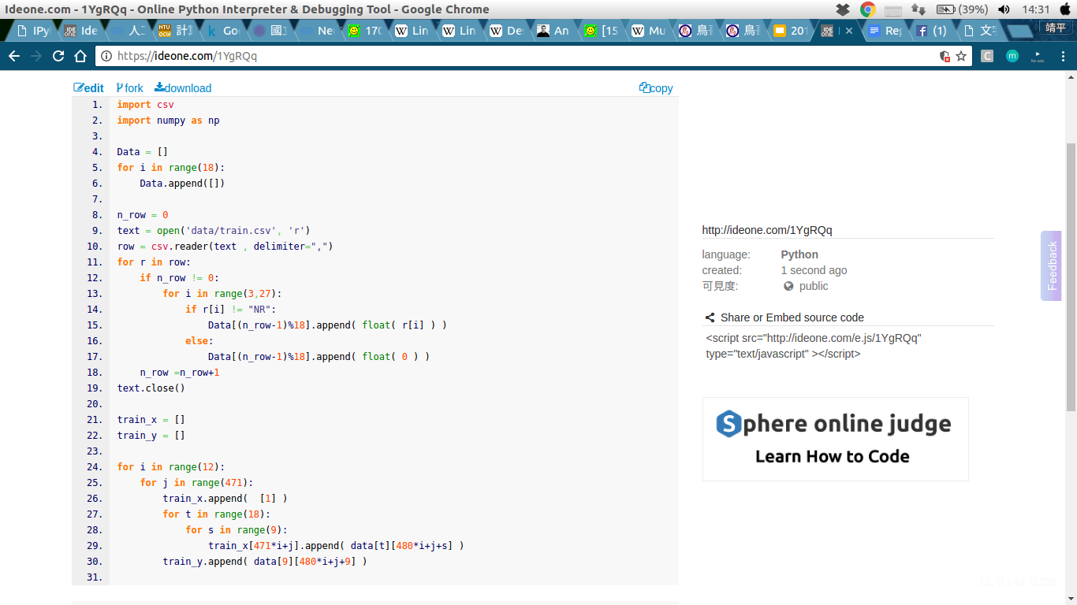
Code available

Slide 8
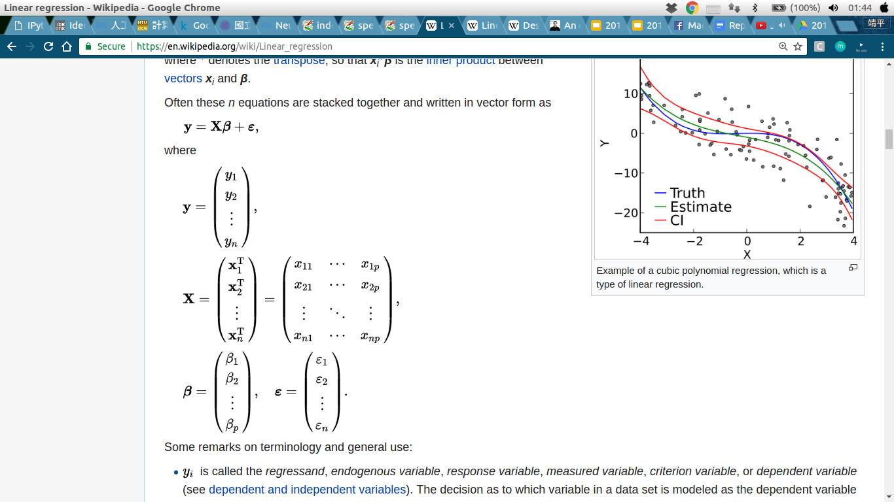
實做linear regression
(Pseudo code) 1. 宣告weight vector、初始learning rate、# of iteration 2. for i_th iteration : 3. y’ = train_x 和 weight vector 的 內積 4. L = y’ - train_y 5. gra = 2*np.dot( (train_x)’ , L ) 6. weight vector -= learning rate * gra
Notes:
解釋y’(vector) and train_x(matrix)

Slide 9
2. for i_th iteration : 3. y’ = train_x 和 weight vector 的 內積 4. L = y’ - train_y 5. gra = 2*np.dot( (train_x)’ , L ) 6. weight vector -= learning rate * gra
3.
‘
‘
.
=
‘
4.
‘
‘
L
=
-
‘
5.
x11 | x21 | ... | xn1
. |  |  | .
. |  |  | .
x1p | x2p | ... | xnp
-
‘
-
‘
gra = 2*
.
‘
-
p-dim vector

Slide 10
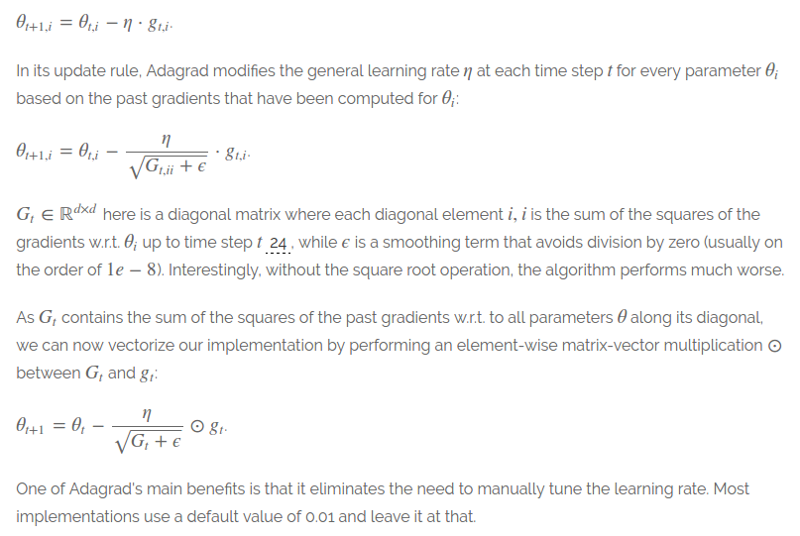
Adagrad

Slide 11
實做linear regression
(Pseudo code) 1. 宣告weight vector、初始learning rate、# of iteration 宣告prev_gra儲存每個iteration的gradient 2. for i_th iteration : 3. y’ = train_x 和 weight vector 的 內積 4. L = y’ - train_y 5. gra = 2*np.dot( (train_x)’ , L ) prev_gra += gra**2 ada = np.sqrt(prev_gra) 6. weight vector -= learning rate * gra / ada

Slide 12
預測 PM 2.5
(Pseudo code) 1. read test_x.csv 2. every 18 rows : 3. test_x.append([1]) 4. test_x.append(這9小時的data) 5. test_y = np.dot( weight vector, test_x)

Slide 13
Reference
adagrad : http://sebastianruder.com/optimizing-gradient-descent/index.html#batchgradientdescent
linear regression : https://en.wikipedia.org/wiki/Linear_regression

